Slide 1
Movie Review Sentiment Intelligence
Fine-Grained Sentiment & Aspect Extraction Using Transformer-Based NL
Presented by Serge Nane

Slide 2
Introduction
Project Overview & Objectives
Analyze 50,000 IMDB movie reviews to understand viewer sentiment.
Go beyond simple positive/negative classification to identify key movie aspects (acting, plot, direction …).
Compare traditional ML (Logistic Regression + TF-IDF) with transformer models (BERT).
Provide insights useful for studios and streaming platforms.

Slide 3
Dataset & Preprocessing
Dataset
IMDB Large Movie Review Dataset (50,000 reviews)
Balanced classes (25,000 positive, 25,000 negative)
Preprocessing Steps
Remove HTML tags (e.g., <br />) and punctuation
Convert to lowercase and clean text
Remove stopwords and apply lemmatization
Result: Cleaned text ready for modeling

Slide 4
Exploratory Data Analysis (EDA)
Key Findings
Positive keywords: great, love, excellent
Negative keywords: bad, awful, terrible
Common themes: film, story, character → shared across sentiments
Avg. review length ≈ 118 words; length not predictive of sentiment

Slide 5
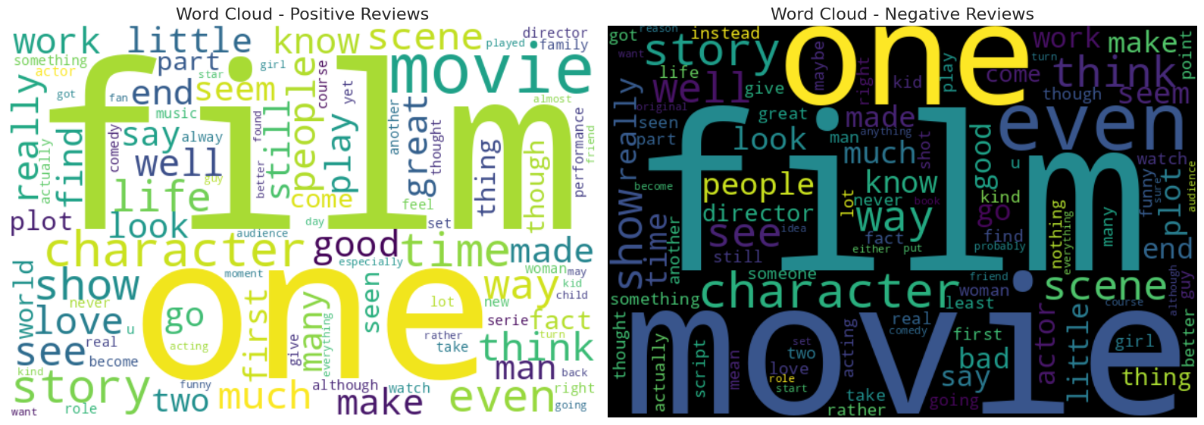
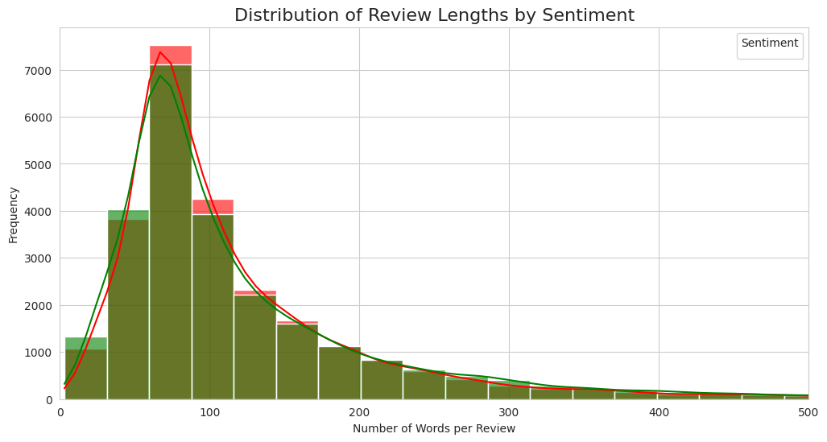
Visualizations

Slide 6
Baseline Model (TF-IDF + Logistic Regression)
Performance
Accuracy ≈ 88.9 % | F1 = 0.89
Balanced precision & recall
Learned clear signals — “great”, “excellent” vs “worst”, “awful”
Takeaway: Strong baseline but limited context awareness.

Slide 7
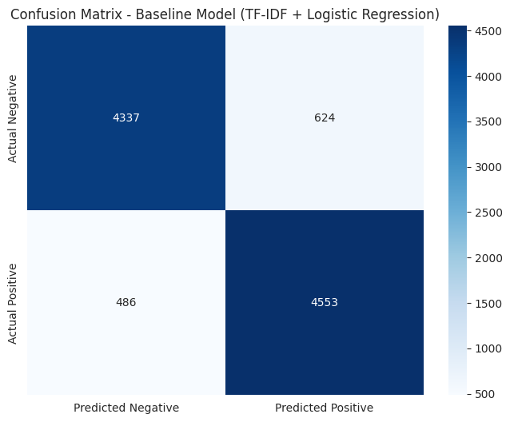
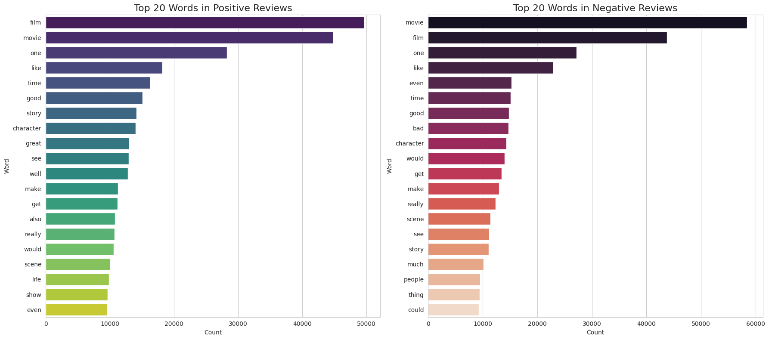
Visualizations

Slide 8
Advanced Model (BERT Transformer)
Fine-Tuned Model: distilbert-base-uncased
Performance Improvement
Accuracy → 91.23 % (+2.32 % vs baseline)
Precision 91.22 % | Recall 91.39 % | F1 91.31 %
Insights
Captures context (sarcasm, negation)
Balanced across classes → production-ready

Slide 9
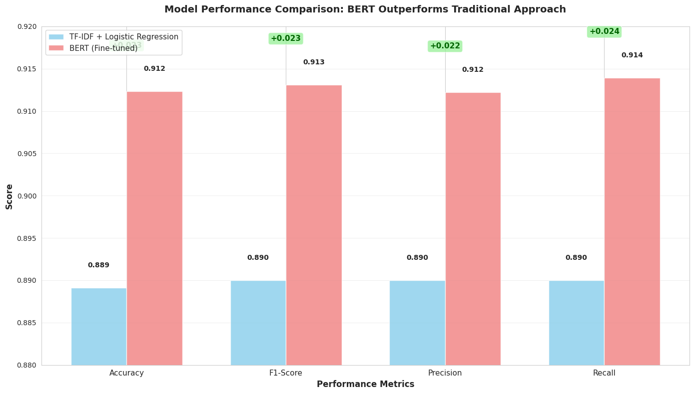
Visualizations

Slide 10
Aspect Extraction (LDA Topics)
Aspect | Example Top Words | % of Reviews
Overall Quality | movie, film, good | 94 %
Acting | actor, role, performance | 67 %
Plot | story, life, love | 61 %
Technical | music, effect, sound | 38 %
Direction | director, scene, camera | 35 %

Slide 11
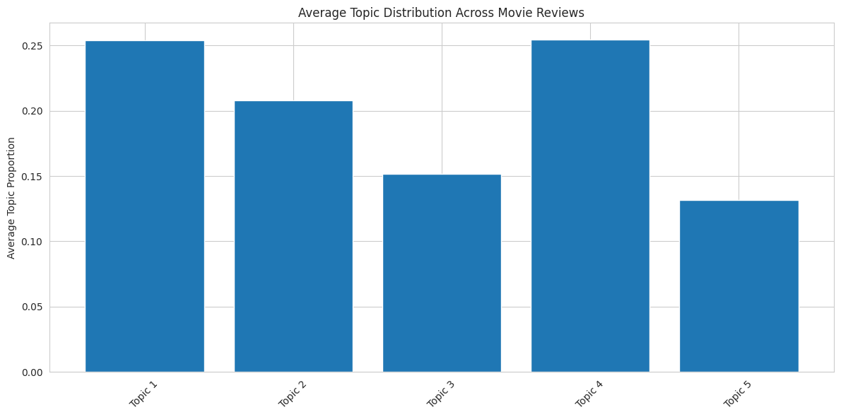
Visualizations

Slide 12
Insights & Business Impact
Key Insights
BERT outperforms traditional models (+2.32 %).
Acting & plot dominate review content.
Aspect analysis enables targeted feedback for studios.
Business Impact
Automates review analysis at scale.
Reduces manual effort with > 91 % accuracy.
Supports data-driven decisions on casting & storytelling.

Slide 13
Ethical & Future Work
Ethical Considerations
Public, anonymized data only
Bias and fairness monitoring
Human-in-loop interpretation
Future Work
Improve sarcasm detection
Extend to multilingual reviews
Real-time dashboard for review monitoring

Slide 14
Conclusion
Transformer models achieve state-of-the-art performance.
Fine-grained aspect extraction offers actionable insights.
Framework can generalize to product reviews, music, games …
Accuracy: 91.23 % | Impact: Smarter audience understanding

Slide 15
THANK YOU!

